Slide 1
Time Series Analysis
Apr 8, 2022
Gwangwoo Kim

Slide 2





8.1.2 Overfitting
Suppose we have
equivalently
extension
equivalently
check whether nonzero values of 𝜆1 and 𝜆2
by using

Slide 3
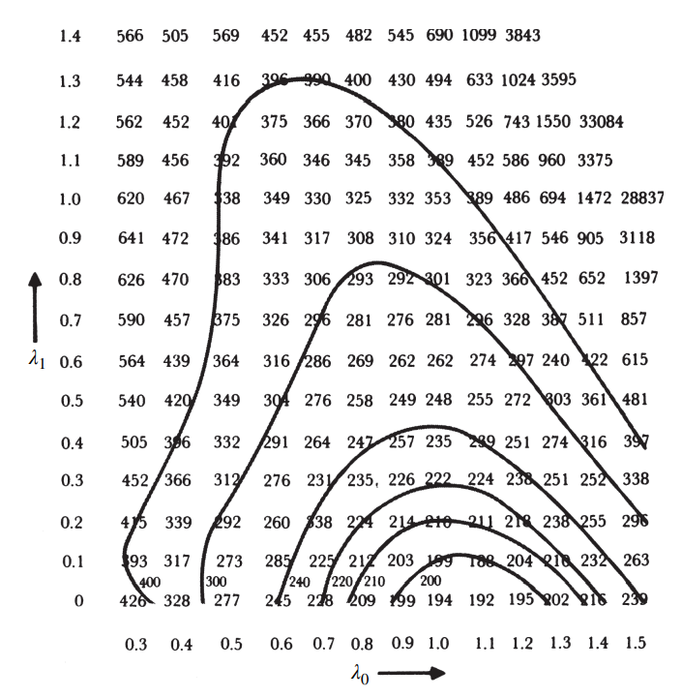
8.1.2 Overfitting
As a result, lambdas are zeros!!

Slide 4
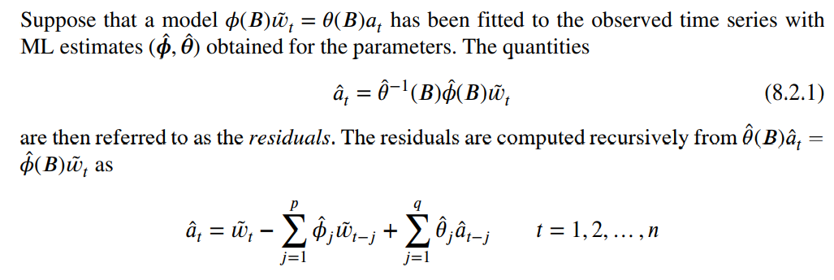
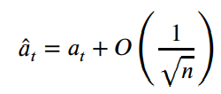
8.2.1 Autocorrelation Check
In general, we don’t know what kind of extensions are used.
<Fact> is true if the model is adequate

Slide 5
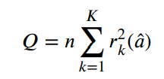
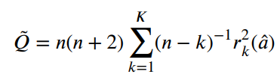
8.2.2 Portmanteau Lack-of-Fit Test
However, it was pointed out by Durbin (1970) that it might be dangerous to assess the statistical significance of apparent discrepancies of the estimated autocorrelations of the residuals from their theoretical zero values on the basis of a standard error.
Suppose that we have the first 𝐾 autocorrelations (𝑘 = 1, 2, … , 𝐾) from any ARIMA(𝑝, 𝑑, 𝑞) model
<Fact> goes to chi^2(K-p-q) where n=N-d
(Ljung−Box)
Is recommend for small sample sizes

Slide 6
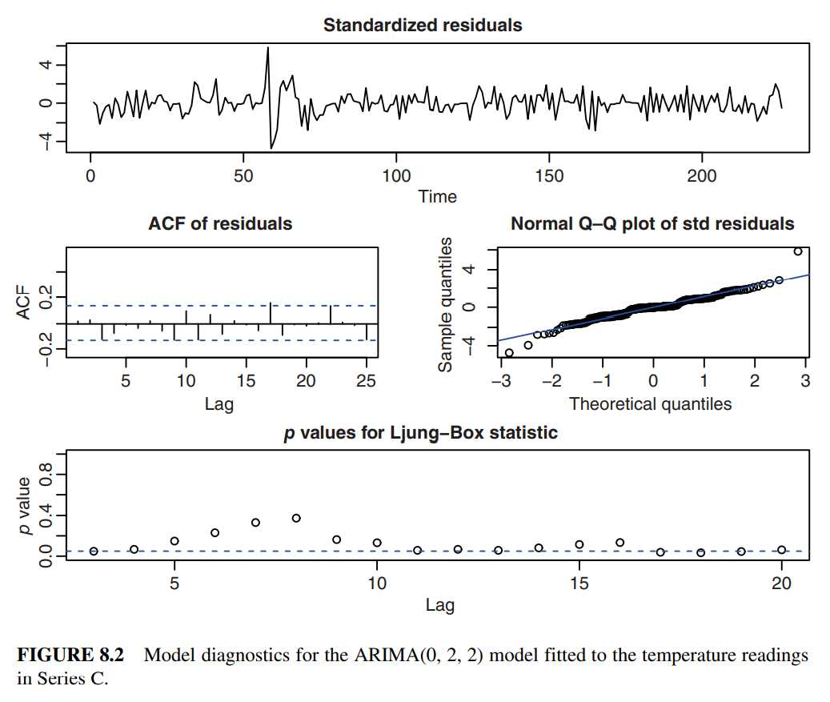
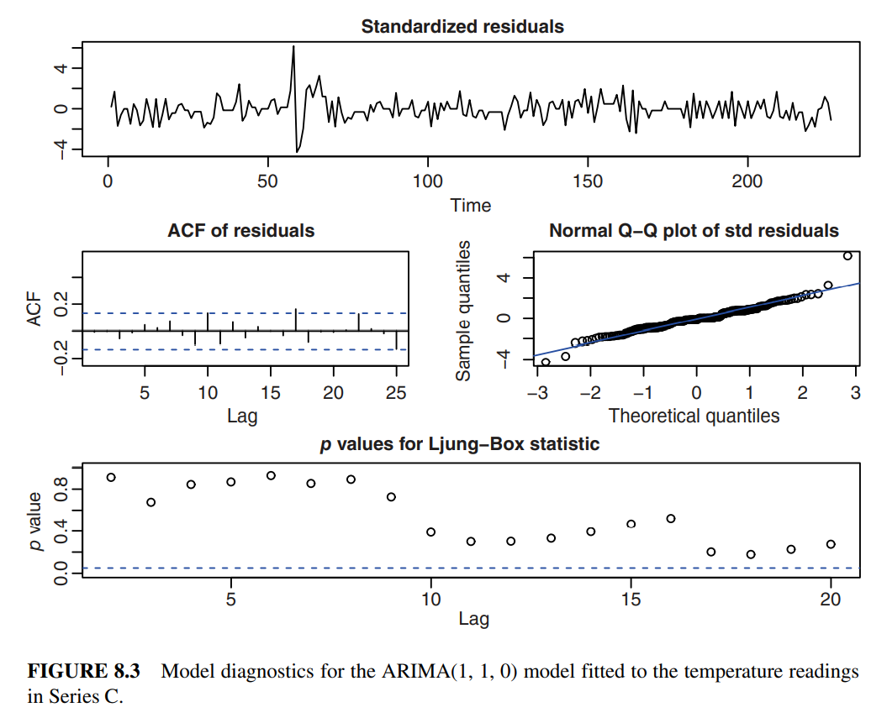

Slide 7
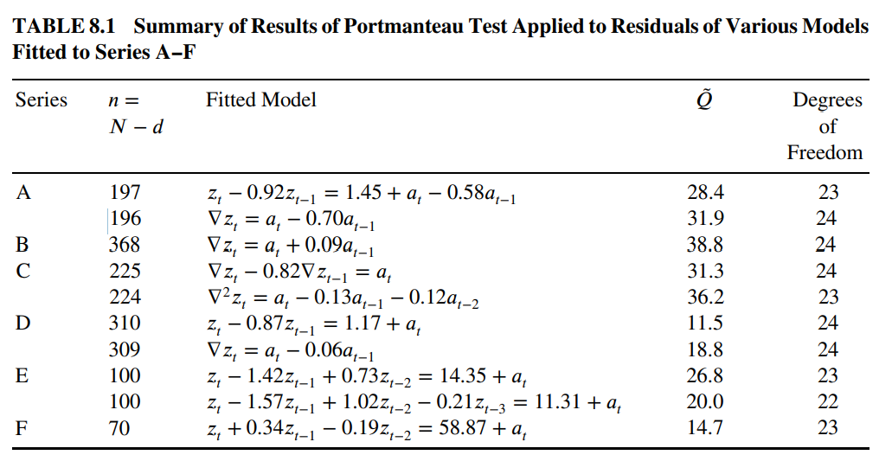

Slide 8
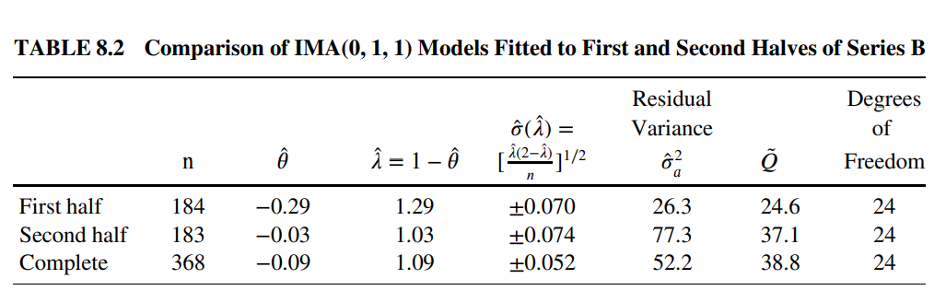


8.2.3 Model Inadequacy Arising from Changes in Parameter Values
A real change in variability has occurred between the two halves of the series.

Slide 9
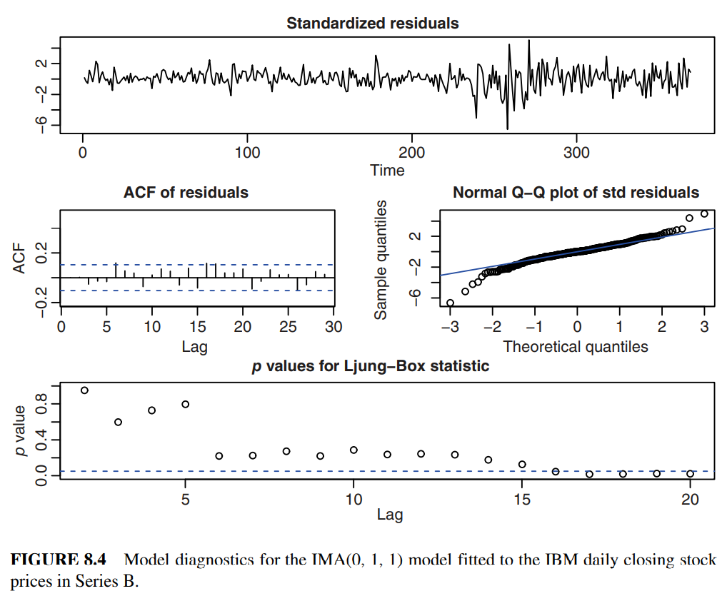


8.2.3 Model Inadequacy Arising from Changes in Parameter Values
𝑡 = 236

Slide 10



8.2.4 Score Tests for Model Checking
Null hypothesis
Alternative hypothesis
or

Slide 11

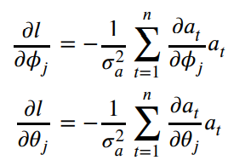

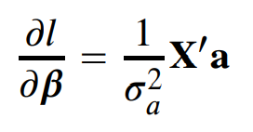
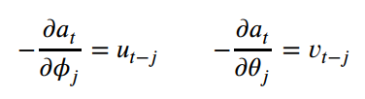
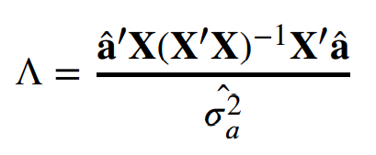
8.2.4 Score Tests for Model Checking
Need partial derivatives
Information is estimated by
result
ML fitting under the null hypothesis
Chi r

Slide 12
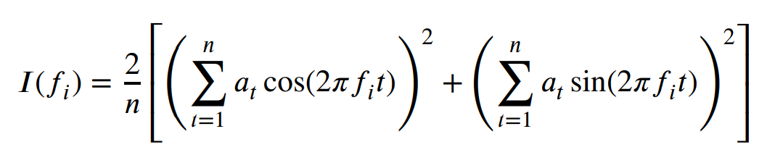

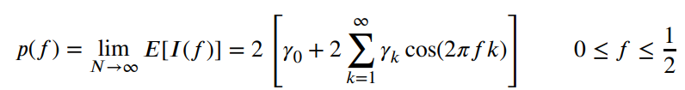
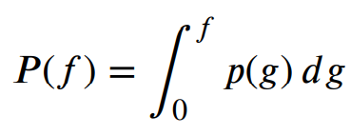
8.2.5 Cumulative Periodogram Check
Cumulative Periodogram:

Slide 13

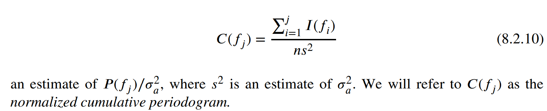
8.2.5 Cumulative Periodogram Check
<Note> The periodogram 𝐼(𝑓) provides an estimate of the power spectrum at frequency 𝑓.
Is estimated by
Moreover, true C(f) will be a straight-line running from (0,0) to (0,5,1)

Slide 14



8.2.5 Cumulative Periodogram Check
(well)
Is inadequate
(less well)

Slide 15
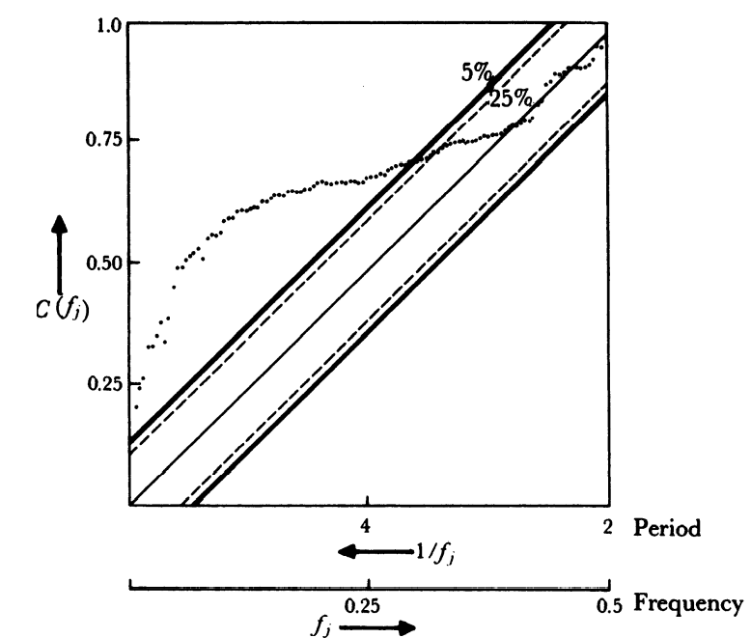
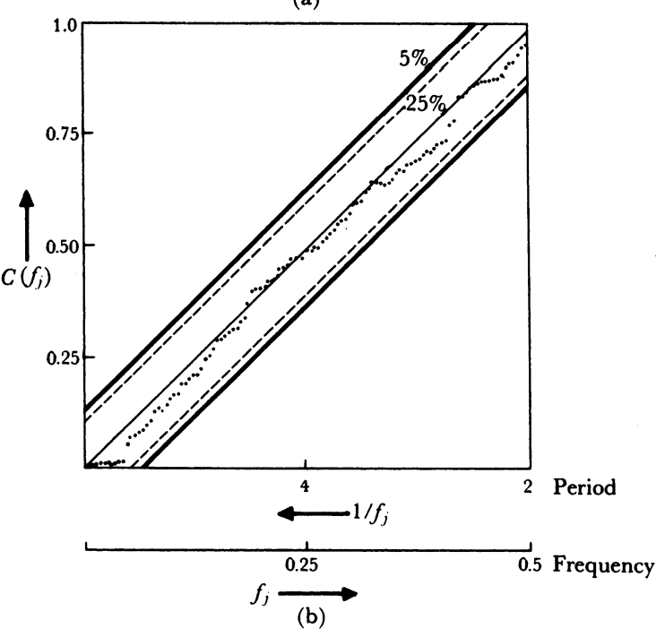

8.2.5 Cumulative Periodogram Check

Slide 16
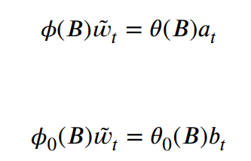


8.3.1 Nature of the Correlations in the Residuals When an Incorrect Model Is Used
correct
(See ratio)
incorrect
Autocovariance generating function
If b is nonrandom, then it could be modeled with white noise,
which might suggest a modified model.

Slide 17


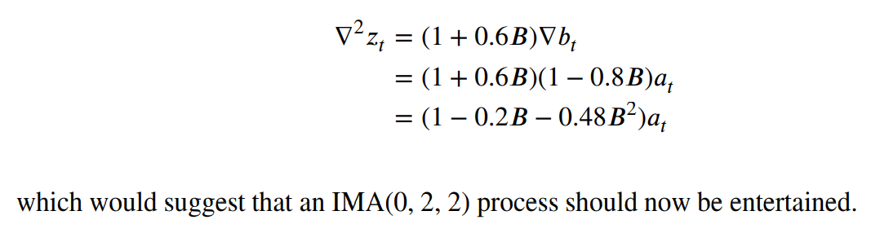
8.3.1 Nature of the Correlations in the Residuals When an Incorrect Model Is Used
wrongly identified
identified for this residual series

